Slide 1



MARATHON ASSET MANAGEMENT
CORNELL CFEM CAPSTONE 2026
Marathon Project Meeting
Index Construction Using YTM
SPONSOR: Jason Foster
ADVISOR: Sasha Stoikov
TEAM: Alex Lee, Max Yap, Minxi Lin, Yung Lee, Olivia Mei
DATE: September 17, 2026

Slide 2
MARATHON ASSET MANAGEMENT
FV/PAR/Maturity Availability by Row
CORNELL CFEM CAPSTONE 2026
FV | PAR | Maturity | Rows | % of Total
Available | Available | Available | 172,394 | 35.0%
Available | Available | Missing | 293,176 | 59.4%
Available | Missing | Available | 8,053 | 1.6%
Available | Missing | Missing | 5,011 | 1.0%
Missing | Available | Available | 3,182 | 0.6%
Missing | Available | Missing | 100 | 0.0%
Missing | Missing | Available | 5,252 | 1.1%
Missing | Missing | Missing | 6,014 | 1.2%
None of TotalInterestRate (Coupon Rate), PIC, and PIK are missing after applying imputation and dropping all-missing rows (in the data cleaning stage).

Slide 3
MARATHON ASSET MANAGEMENT
Maturity Imputation Pipeline
CORNELL CFEM CAPSTONE 2026
Key Rule: Accept a candidate date d only if TTM(d) = (d - period) / 365.25 ∈ [0.1, 7.0] years
(rules out already-matured or implausibly long-dated positions)
1. For rows with non-null InvestmentMaturityDate, compute TTM(d).
If it is within the range, accept; else, try the next imputation step.
186,606 rows (37.8%)
2. For the remaining rows, try parsing from investment_identifier text.
use regex match, such as “Due 10/19/2027”, “Maturity Date 03/22/39”, “due 8/2030”, etc.
If successful, test if TTM(d) is within the range; otherwise, move onto the next step.
5,058 rows (1.0%)
3. If the above two approaches do not work, use Cliffwater research paper’s default assumption*.
maturity_date_imputed = period + 3 years (default_years = 3 years)
301,518 (61.1%)
*What Do We Mean by Yield? (A discussion of components and calculations underlying direct lending yield), Cliffwater LLC, August 3, 2016.

Slide 4
MARATHON ASSET MANAGEMENT
Flow-Based Index Construction
CORNELL CFEM CAPSTONE 2026
Quarterly Return
ΔFV_{t} − ΔCOST_{t} + C_{t} + P_{t}
r_{t}
=
FV_{t−1}
where:
PIC_{Final, t-1} × PAR_{t-1}
C_{t}
=
(cash interest income)
4
PIK_{Final, t-1} × PAR_{t-1}
P_{t}
=
(PIK interest income)
4

Slide 5
MARATHON ASSET MANAGEMENT
Flow-Based Index Construction
CORNELL CFEM CAPSTONE 2026
Index Return
The quarterly index return is the value-weighted return across investments:
N
R
Index
=
Σ
w_{i,t} r_{i,t}
t
i=1
with portfolio weights determined by beginning-of-quarter fair value:
FV_{i,t−1}
w_{i,t}
=
N
FV_{j,t−1}
Σ
j=1

Slide 6
MARATHON ASSET MANAGEMENT
YTM-Based Index Construction
CORNELL CFEM CAPSTONE 2026
Yield-to-Maturity Calculation
The investment's current fair value is modeled as the present value of quarterly cash interest plus the principal repayment, including PIK accrual:
n
PAR₀·(1+PIK_{Final,0}/4)^{τ -1} · PIC_{Final, 0}/4
PAR₀·(1+PIK_{Final,0}/4)^{n}
FV₀
=
Σ
+
(1+y)^{τ}
(1+y)^{n}
τ =1
where:
• FV₀ = current fair value of the investment
• PAR₀ = current principal amount
• PIC_{Final, 0} = current annual cash interest rate
• PIK_{Final, 0} = current annual PIK interest rate
• n = number of quarters to maturity (rounded to the nearest integer)
• y = quarterly yield

Slide 7
MARATHON ASSET MANAGEMENT
YTM-Based Index Construction
CORNELL CFEM CAPSTONE 2026
Solving for the Yield
The yield y is the solution to:
n
PAR₀·(1+PIK_{Final, 0}/4)^{τ -1} · PIC_{Final, 0}/4
PAR₀·(1+PIK_{Final, 0}/4)^{n}
NPV(y)
=
Σ
+
− FV₀ = 0
τ =1
(1+y)^{τ}
(1+y)^{n}
Applying the Newton–Raphson Method
Starting from an initial guess y₀=IR_{Final} /4 (~99.8% of rows converge under (-0.5, 2.0) cap), the yield is solved iteratively (max_iter = 25) using:
NPV(y_{k})
y_{k+1}
=
y_{k}
−
NPV′(y_{k})
where the derivative is:
n
t · PAR₀·(1+PIK_{Final, 0} /4)^{τ -1} · PIC_{Final, 0} /4
n · PAR₀(1+PIK_{Final, 0} /4)^{n}
NPV′(y)
= −
Σ
−
τ =1
(1+y)^{τ +1}
(1+y)^{n+1}

Slide 8
MARATHON ASSET MANAGEMENT
YTM-Based Index Construction
CORNELL CFEM CAPSTONE 2026
Index Yield
Once the individual investment yields y_{i} have been obtained, the quarterly index yield is the current-quarter fair-value-weighted average:
N
Y
Index
=
Σ
w_{i} y_{i}
q
i=1
with:
FV_{i}
w_{i}
=
N
FV_{j}
Σ
j=1

Slide 9
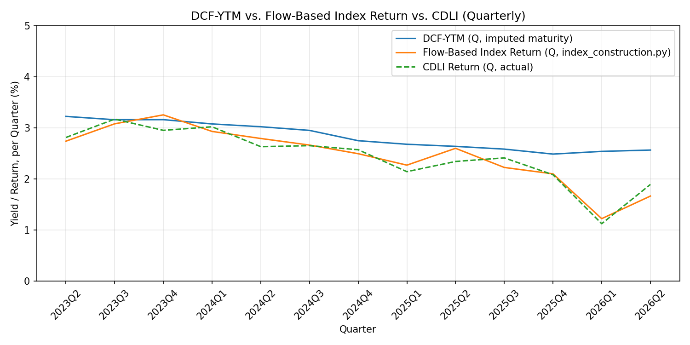
MARATHON ASSET MANAGEMENT
CDLI Tracking Performance
CORNELL CFEM CAPSTONE 2026
Comparison | Correlation | TE (annualized)
DCF-YTM vs. CDLI | 0.821 | 0.724%
Flow-based Index vs. CDLI | 0.958 | 0.327%

Slide 10
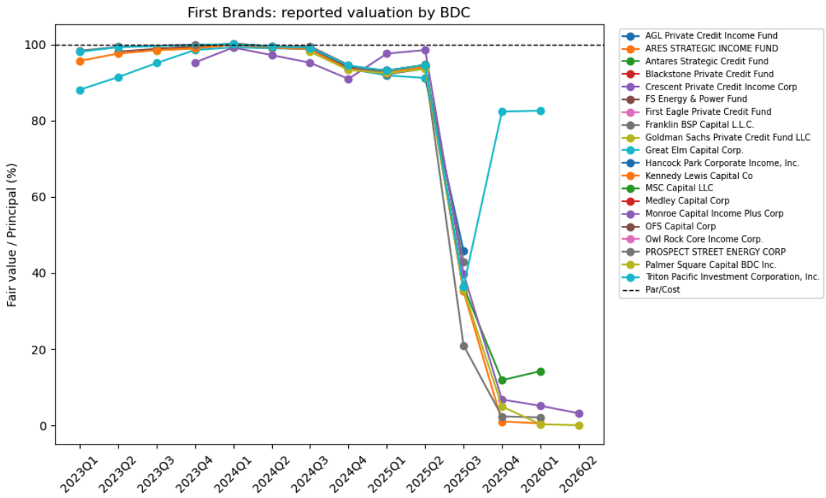
MARATHON ASSET MANAGEMENT
Case Study – First Brands
CORNELL CFEM CAPSTONE 2026

Slide 11
MARATHON ASSET MANAGEMENT
Valuation Dispersion
CORNELL CFEM CAPSTONE 2026
A borrower is only included if it is held by at least 4 distinct BDCs in the exact same quarter
The total aggregate dollar exposure across the lenders must be greater than 30 million
Top 5
Interesting Finding: Negative Valuation
Assumption: Occurs when a lender hasn't handed over any cash, but is legally locked into a contract to lend money to a struggling company (becomes liability)

Slide 12
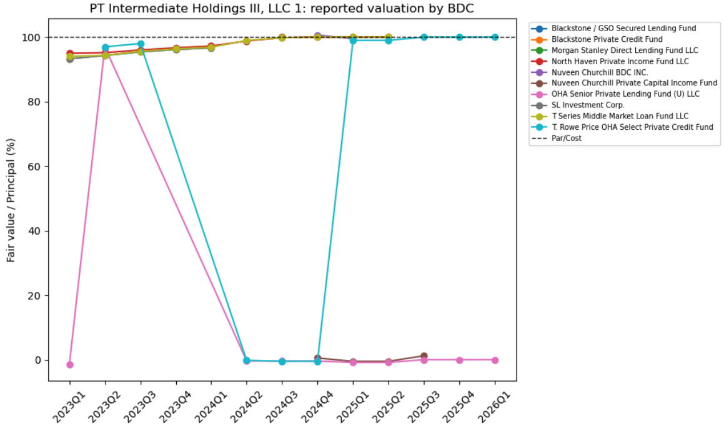
MARATHON ASSET MANAGEMENT
More Case Studies
CORNELL CFEM CAPSTONE 2026

Slide 13
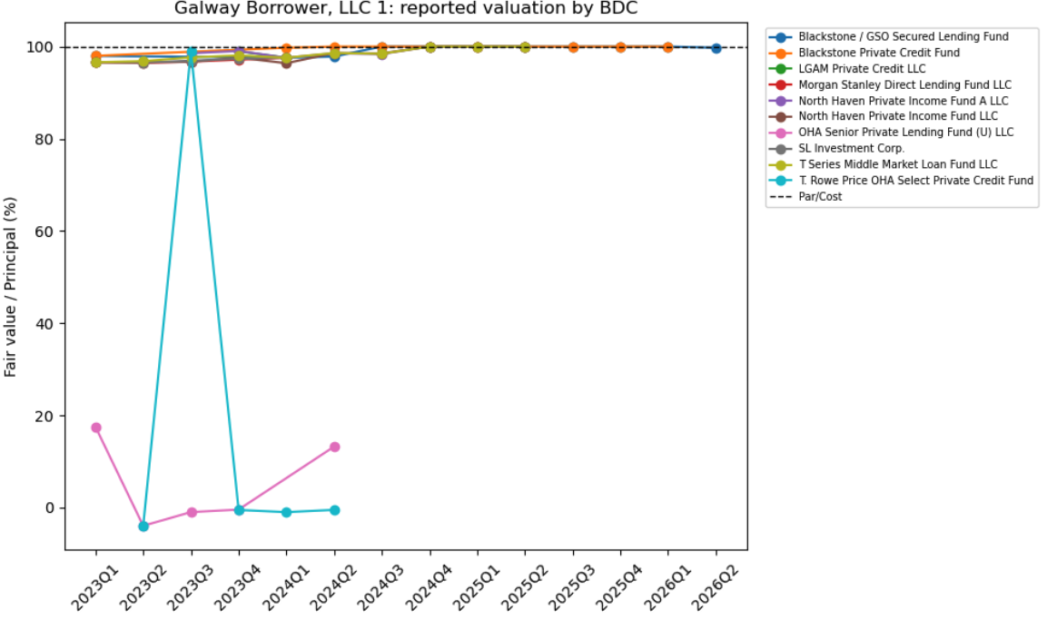
MARATHON ASSET MANAGEMENT
More Case Studies
CORNELL CFEM CAPSTONE 2026

Slide 14
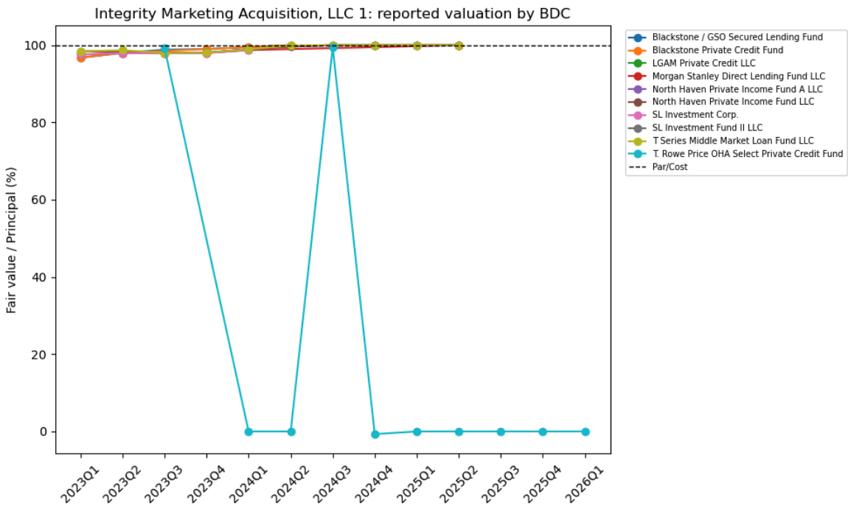
MARATHON ASSET MANAGEMENT
More Case Studies
CORNELL CFEM CAPSTONE 2026

Slide 15
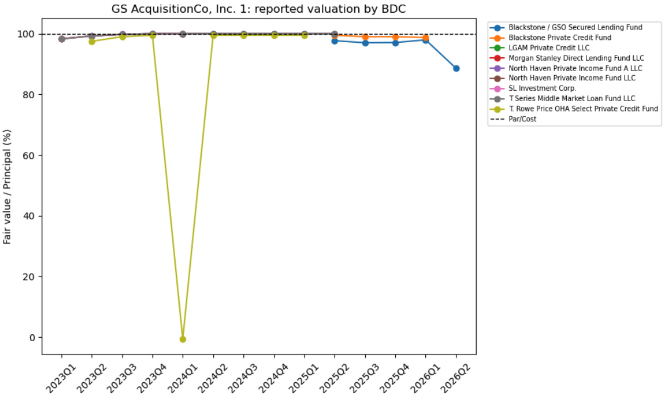
MARATHON ASSET MANAGEMENT
More Case Studies
CORNELL CFEM CAPSTONE 2026

Slide 16
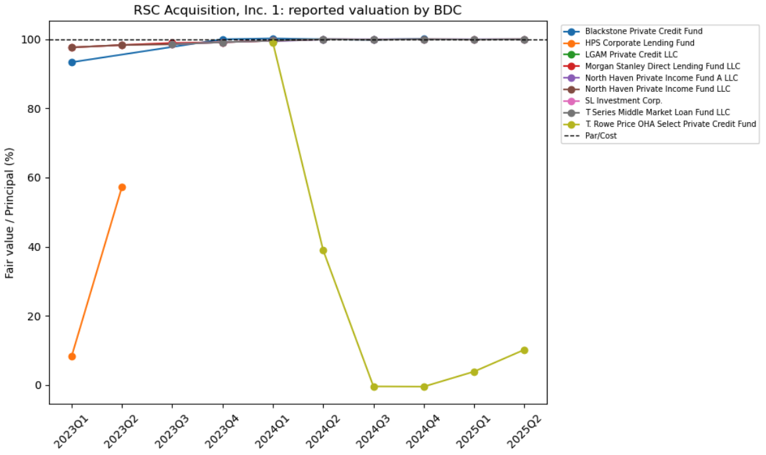
MARATHON ASSET MANAGEMENT
More Case Studies
CORNELL CFEM CAPSTONE 2026

Slide 17
MARATHON ASSET MANAGEMENT
CORNELL CFEM CAPSTONE 2026
Subsector Analysis: Technology 2026Q1
Price return: -2.86%
Software was the main driver: Medallia, Solera, and Cornerstone OnDemand are the top negative contributors
Not highly concentrated: the top 5 negative contributors accounted for only 21.2% of gross negative contribution, while the top 10 accounted for 29.6%
Borrower Name | Negative Contribution | Negative Share | Cumulative Contribution | Subsector
Medallia, Inc. 1 | Non-Affiliated Issuer | 0.31% | 10.28% | 10.28% | Software
Barracuda Parent, LLC | Second lien senior secured loan | Non-Affiliated Issuer | 0.09% | 3.18% | 13.45% | Cybersecurity / Networking
Medallia Inc | Software & Services | 0.09% | 3.05% | 16.50% | Software
Solera LLC | Software & Services | 0.07% | 2.38% | 18.88% | Software
Navigator Acquiror, Inc. | Non-Affiliated Issuer | 0.07% | 2.30% | 21.19% | Unknown / Insufficient Information
Cornerstone OnDemand, Inc. | Second lien senior secured loan | Non-Affiliated | 0.06% | 1.88% | 23.07% | Software
Cornerstone OnDemand, Inc. and Sunshine Software Holdings, Inc., Second lien senior secured loan | 0.05% | 1.83% | 24.90% | Software
Medallia, Inc. 2 | Non-Affiliated Issuer | 0.05% | 1.78% | 26.68% | Software
Cornerstone OnDemand, Inc. and Sunshine Software Holdings, Inc., First lien senior secured loan | 0.05% | 1.54% | 28.22% | Software
Cornerstone OnDemand, Inc. | Second lien senior secured loan | Non-Affiliated Issuer | 0.04% | 1.35% | 29.58% | Software

Slide 18
MARATHON ASSET MANAGEMENT
CORNELL CFEM CAPSTONE 2026
Subsector Analysis: Healthcare 2024Q3
Price return: -0.48%
Highly concentrated: Miami Beach Medical Group has ~46.43% negative contribution
Healthcare services is the main driver
Borrower Name | Negative Contribution | Negative Share | Cumulative Share | Subsector
Miami Beach Medical Group LLC, Health Care Equipment & Services 2 | 0.42% | 43.99% | 43.99% | Healthcare Services
National Dentex Labs LLC (fka Barracuda Dental LLC), First lien senior secured loan | 0.06% | 6.71% | 50.70% | Dental
Covetrus, Inc., Second lien senior secured loan | 0.02% | 2.50% | 53.20% | Other Healthcare
Miami Beach Medical Group LLC, Health Care Equipment & Services 3 | 0.02% | 2.44% | 55.65% | Healthcare Services
Wellpath Holdings, Inc., Health Care Providers & Services, Second Lien Term Loan | 0.02% | 1.80% | 57.44% | Healthcare Services
Medical Solutions Holdings, Inc., Health Care Providers & Services, Second Lien Term Loan | 0.02% | 1.75% | 59.20% | Healthcare Services
STATinMED, LLC., Senior Secured First Lien Debt, 7/1/2027 Maturity, 1 | 0.01% | 1.54% | 60.74% | Unknown / Insufficient Information
PetVet Care Centers, LLC, First lien senior secured loan | 0.01% | 1.49% | 62.23% | Other Healthcare
Wellpath Holdings, Inc., Health Care Providers & Services, First Lien Term Loan | 0.01% | 1.48% | 63.71% | Healthcare Services
Laboratories Bidco LLC and Laboratories Topco LLC, First lien senior secured loan 1 | 0.01% | 1.35% | 65.06% | Diagnostics / Labs

Slide 19
MARATHON ASSET MANAGEMENT
CORNELL CFEM CAPSTONE 2026
Subsector Analysis: Financials 2026Q1
Price return: -0.96%
Highly diffused: top 10 negative contributors only account for 18.14%
Insurance and Asset Management led the top-ten mix, but each remained modest.
Borrower Name | Negative Contribution | Negative Share | Cumulative Share | Subsector
Trucordia Insurance Holdings, LLC | Second lien senior secured loan | Non-Affiliated Issuer | 0.03% | 2.94% | 2.94% | Insurance
RAD CLO 27, Ltd. - Subordinated Notes | Non-Affiliated Issuer | 0.02% | 2.39% | 5.33% | Asset Management
Alera Group, Inc. | Second lien senior secured loan | Non-Affiliated Issuer | 0.02% | 2.37% | 7.70% | Insurance
ANCHF 2025-19, Collaterized loan obligation | 0.02% | 2.00% | 9.69% | Asset Management
CoreLogic, Inc. | Non-Affiliated Issuer | 0.02% | 1.74% | 11.43% | Unknown / Insufficient Information
DIA Finance S.L.U. | Non-Affiliated Issuer | 0.01% | 1.40% | 12.83% | Specialty Finance / Lending
MDPK 2025-75, Collaterized loan obligation | 0.01% | 1.38% | 14.21% | Asset Management
Trucordia Insurance Holdings, LLC | First lien senior secured loan | Non-Affiliated Issuer | 0.01% | 1.35% | 15.56% | Insurance
Trucordia Insurance Holdings, LLC | Second lien senior secured loan | Non-Affiliated | 0.01% | 1.31% | 16.87% | Insurance
AQ Carver Buyer, Inc. (dba CoAdvantage) | First lien senior secured loan | Non-Affiliated Issuer | 0.01% | 1.27% | 18.14% | Other Financials

